Slide 1
Floating Point Range

Slide 2
Special Values (single-precision)
E’ | F | Meaning | Notes
00000000 | 0…0 | 0 | +0.0 and -0.0
00000000 | X…X | Valid number | Non normalized or denormal number = (-1)Sx 2^(-126)x (0.F)
11111111 | 0…0 | Infinity
11111111 | X…X | Not a Number

Slide 3
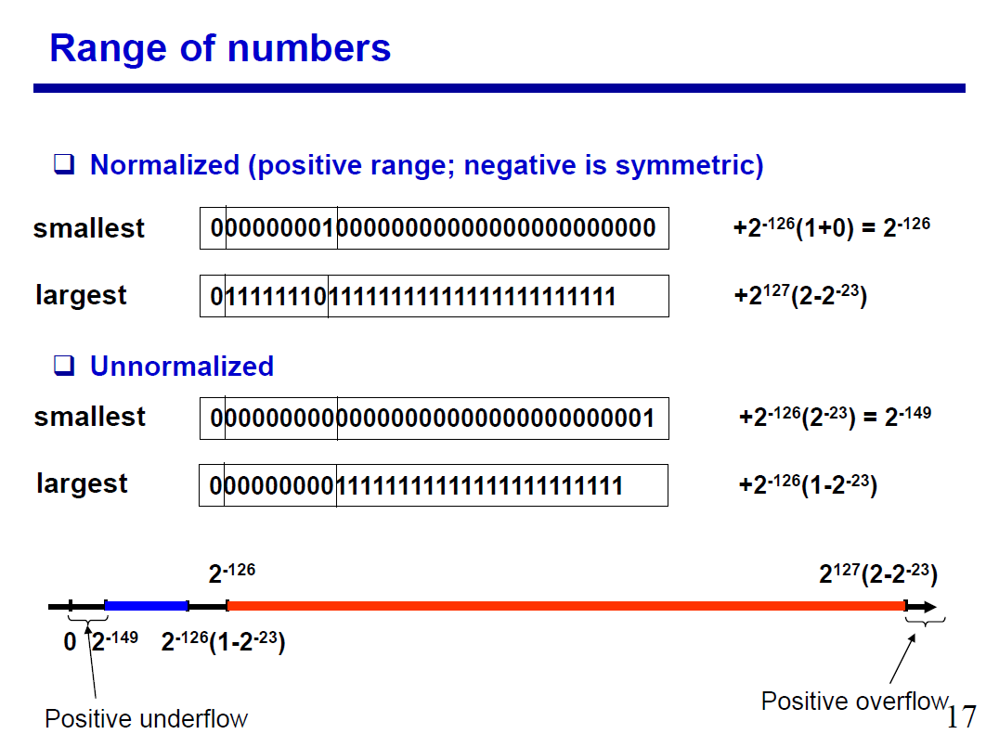

Slide 4
Compare FP numbers ( <, > ? )
Examples:
1 . A= 0 0111 1111 110…0 B=0 1000 0000 110…0
+(1.11)2×2^ (127-127) =1.750 +(1.11)2×2 ^(128-127)= (11.1)2=3.500
0 0111 1111 110…0 0 1000 0000 110…0
+0111 1111 < + 1000 0000 implies B>A
directly comparing exponents as unsigned values gives result
2. A= 1 0111 1111 110…0 B= 1 1000 0000 110…0
-f ×2^(0111 1111 ) -f ×2^(1000 0000)
For exponents: 0111 1111 < 1000 0000
So -f ×2(0111 1111 ) > -f ×2(1000 0000)
If ( both S=1) and (E‘B > E‘A) then A > B

Slide 5
Floating Point addition is not Associative
( x + y) + z ≠ x + ( y + z )
(1.101100…00x 2^127 - 1.101100..00x 2^127)+1 = 1
1.101100..00x 2^127+ (1 –1 .101100..00x2^127)=
(1 –1 .101100..00x2^127)=
0.(26zeros 1x 2^127) - 1 .101100..00x2^127
0.(26zeros 1x 2^127)= 0 in single precision fp
1.101100..00x 2^127 - 1.101100..00x 2^127= 0

Slide 6
Assignment
1. (A B C D 0 0 0 0 0 0 0 0 0 0 0 0)₁₆ is in
IEEE double precision floating point format.
Convert to its decimal value.
Represent binary +tive number 1101011 in IEEE single precision floating point format.
Represent decimal number -0.75 in IEEE single precision floating point format.

Slide 7
Example
Represent (+7)₁₀ in IEEE double precision floating point :
1.Convert to binary (+7)₁₀= (111)₂
2.Normalized (111)₂ = 1.11 x 2²
3. 52 bit mantissa = 110…………………000
50 zeros
4. Biased exponent in excess 1023 = 2+1023=1025
2¹⁰ 2⁰
0 1 000 000 000 1 110…………………000
Biased exponent in 50 zeros
excess 1023

Slide 8
Floating Point Rep --Underflow
Result of arithmetic operation on floating point number too small to be stored in computer then underflow
2 floating point numbers are subtracted
If at least one zero is in most significant position of mantissa then underflow
i.e. result= 0.0001111 x 2 is underflow
Corrected to 1.111 x 2⁻⁴
By left shift and decreasing exponent until non zero bit in left most position

Slide 9
Floating Point Rep --Underflow
In division of floating point numbers exponents are subtracted
If exponent E’ < 1 or E <-126 (in single precision)and E< - 1022(in double precision) then underflow
Cannot be Corrected

Slide 10
Floating Point Rep --Overflow
Result of arithmetic operation on floating point number too large to be stored in computer then overflow
2 floating point numbers of same sign are added.
If carry from most significant position
then mantissa overflow
i.e. result= 10.1111 x 2 is overflow
Corrected to 1.01111 x 2²
By right shift and increasing exponent by same amount

Slide 11
Floating Point Rep --Overflow
In multiplication of floating point numbers exponents are added
If exponent E’ > 254 or E > 127 (in single precision)and E’ > 2046 or E> 1023(in double precision) then overflow
Cannot be Corrected

Slide 12
Floating Point Rep of Num
Single precision floating point normalized number with exponent: range
-126<=E<=127, 1<=E’<=254
Double precision floating point normalized number with exponent range
-1022<=E<=1023, 1<=E’<=2046
Special Values :
E’=0,M=0 exact zero value represented
E’=255,M=0 infinity(i.e. divide by zero a normal num)
Two more

Slide 13
Special Values defined for IEEE Standard Floating Point Format (754)
E’=0,M=0 exact zero value represented
E’=255,M=0 infinity(i.e. a normal num divide by zero)
E’= 0, M not =0 denormal numbers
(+/-)0.M x 2⁻¹²⁶
Gradual underflow accommodated to handle very
small numbers
E’=255, M not = 0 Not a Number(NaN) – result of zero divided by zero, √-1

Slide 14
How are special values set?
Processor sets exception flag for:
  Underflow
  Overflow
  Divide by zero (E’=255 set, M=0 set:- infinity)
  Invalid( if 0/0 or √-1 operation attempted)
    (E’=255 and M= non zero set :- NaN not a number)
  Inexact (if rounding off required)
When exceptions occur, results are set to special value

Slide 15
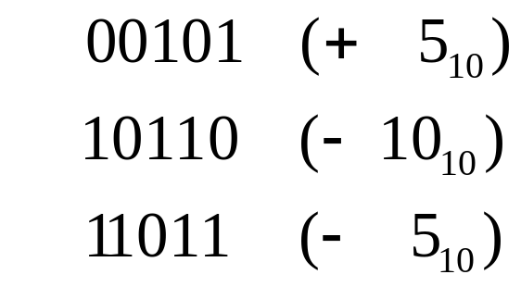
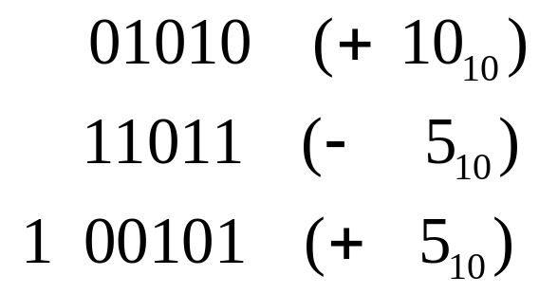
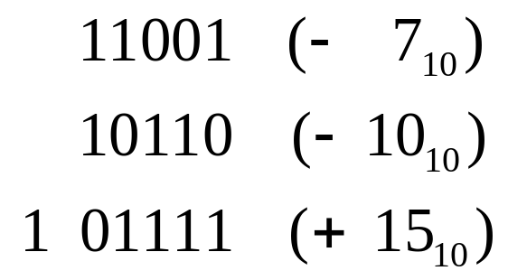
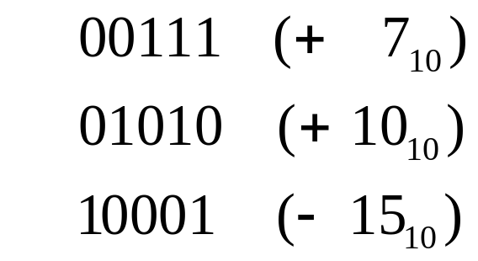
2’s-Complement Overflow
(5 bit signed integer: range(-2⁵⁻¹ to + 2⁵⁻¹ -1)
If X, Y have opposite signs overflow never occurs
whether carry-out exists or not
No
Carry-out
Carry-out
If X, Y have same sign and result sign differs,
overflow occurs
No
Carry-out,
Overflow
Carry-out, Overflow

Slide 16
Overflow: An Error
Examples: Addition of 3-bit integers (range - 4 to +3)
    -2-3 = -5 110 = -2
    + 101 = -3
  = 1011 = 3 (error)
    3+2 = 5 011 = 3
  010 = 2
  = 101 = -3 (error)
Overflow rule:
  If two numbers with the same sign bit (both positive or both negative) are added, the overflow occurs if and only if the result has the opposite sign.
  OR Carry-in into MSB ≠ Carryout from MSB

Slide 17
Floating Pointer Arithmetic Operations

Slide 18
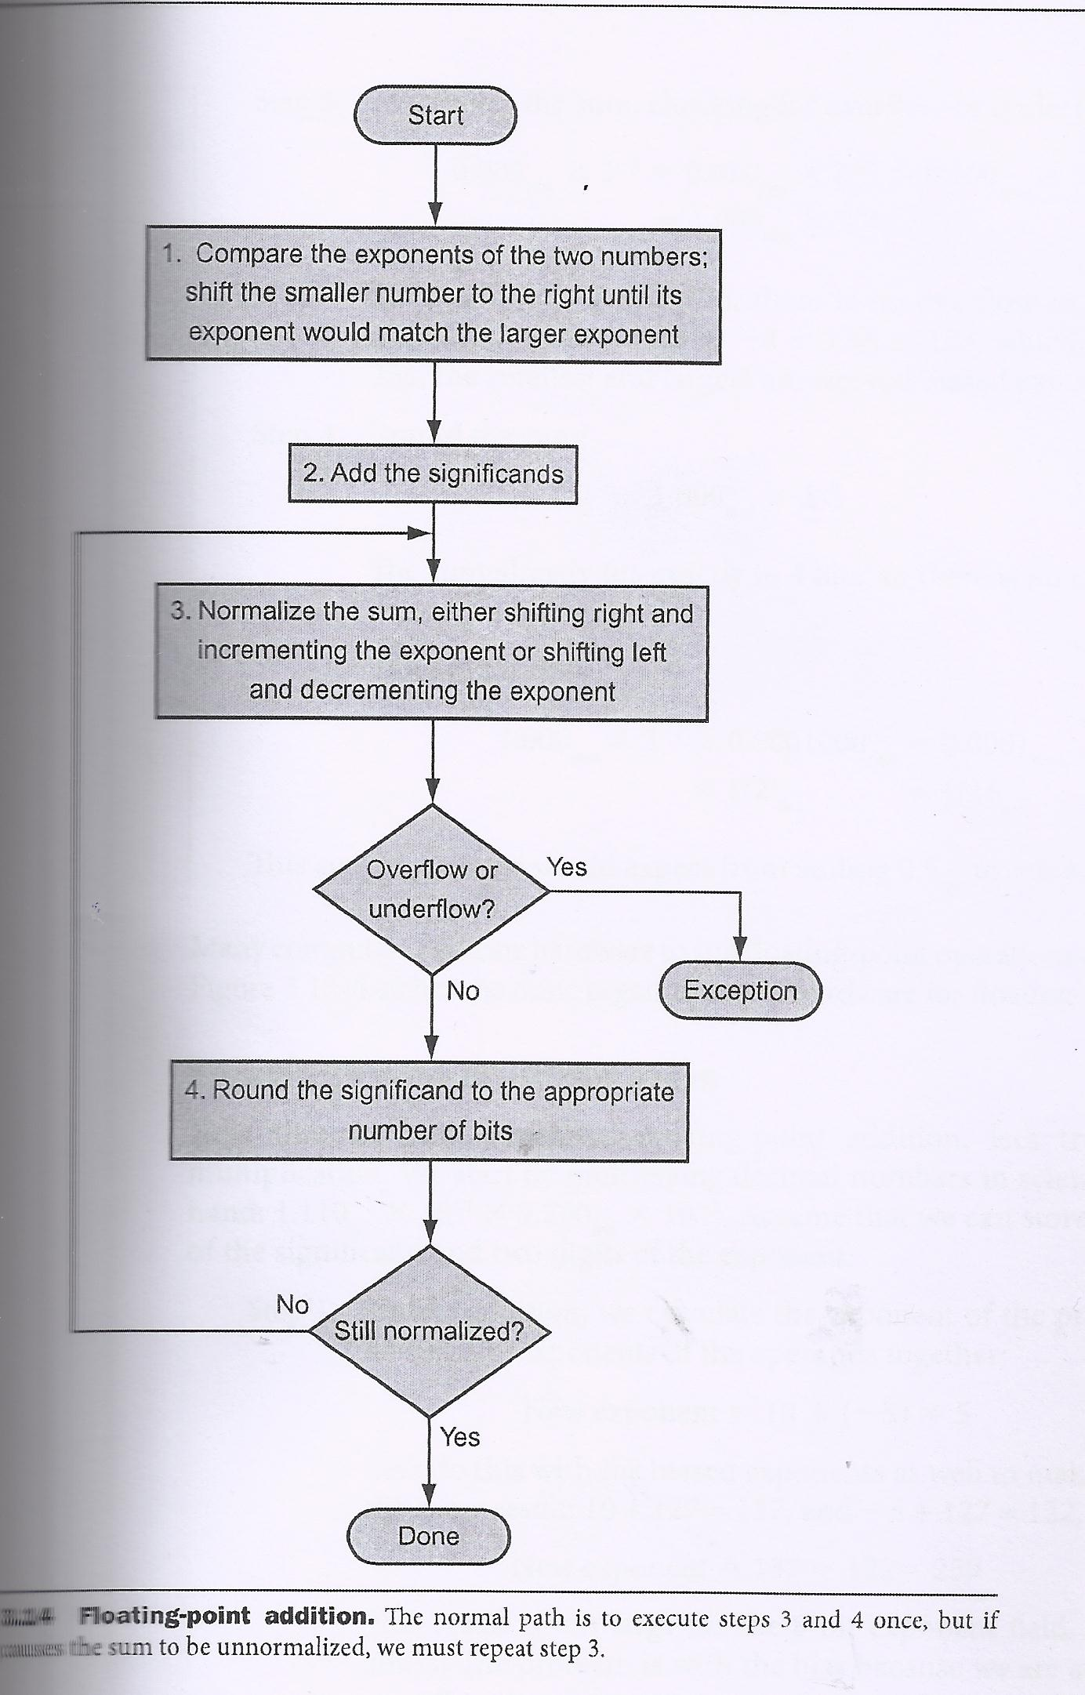
Flow Chart
Floating
Point
Number
Addition

Slide 19
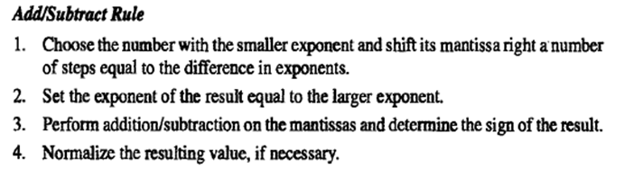

Slide 20
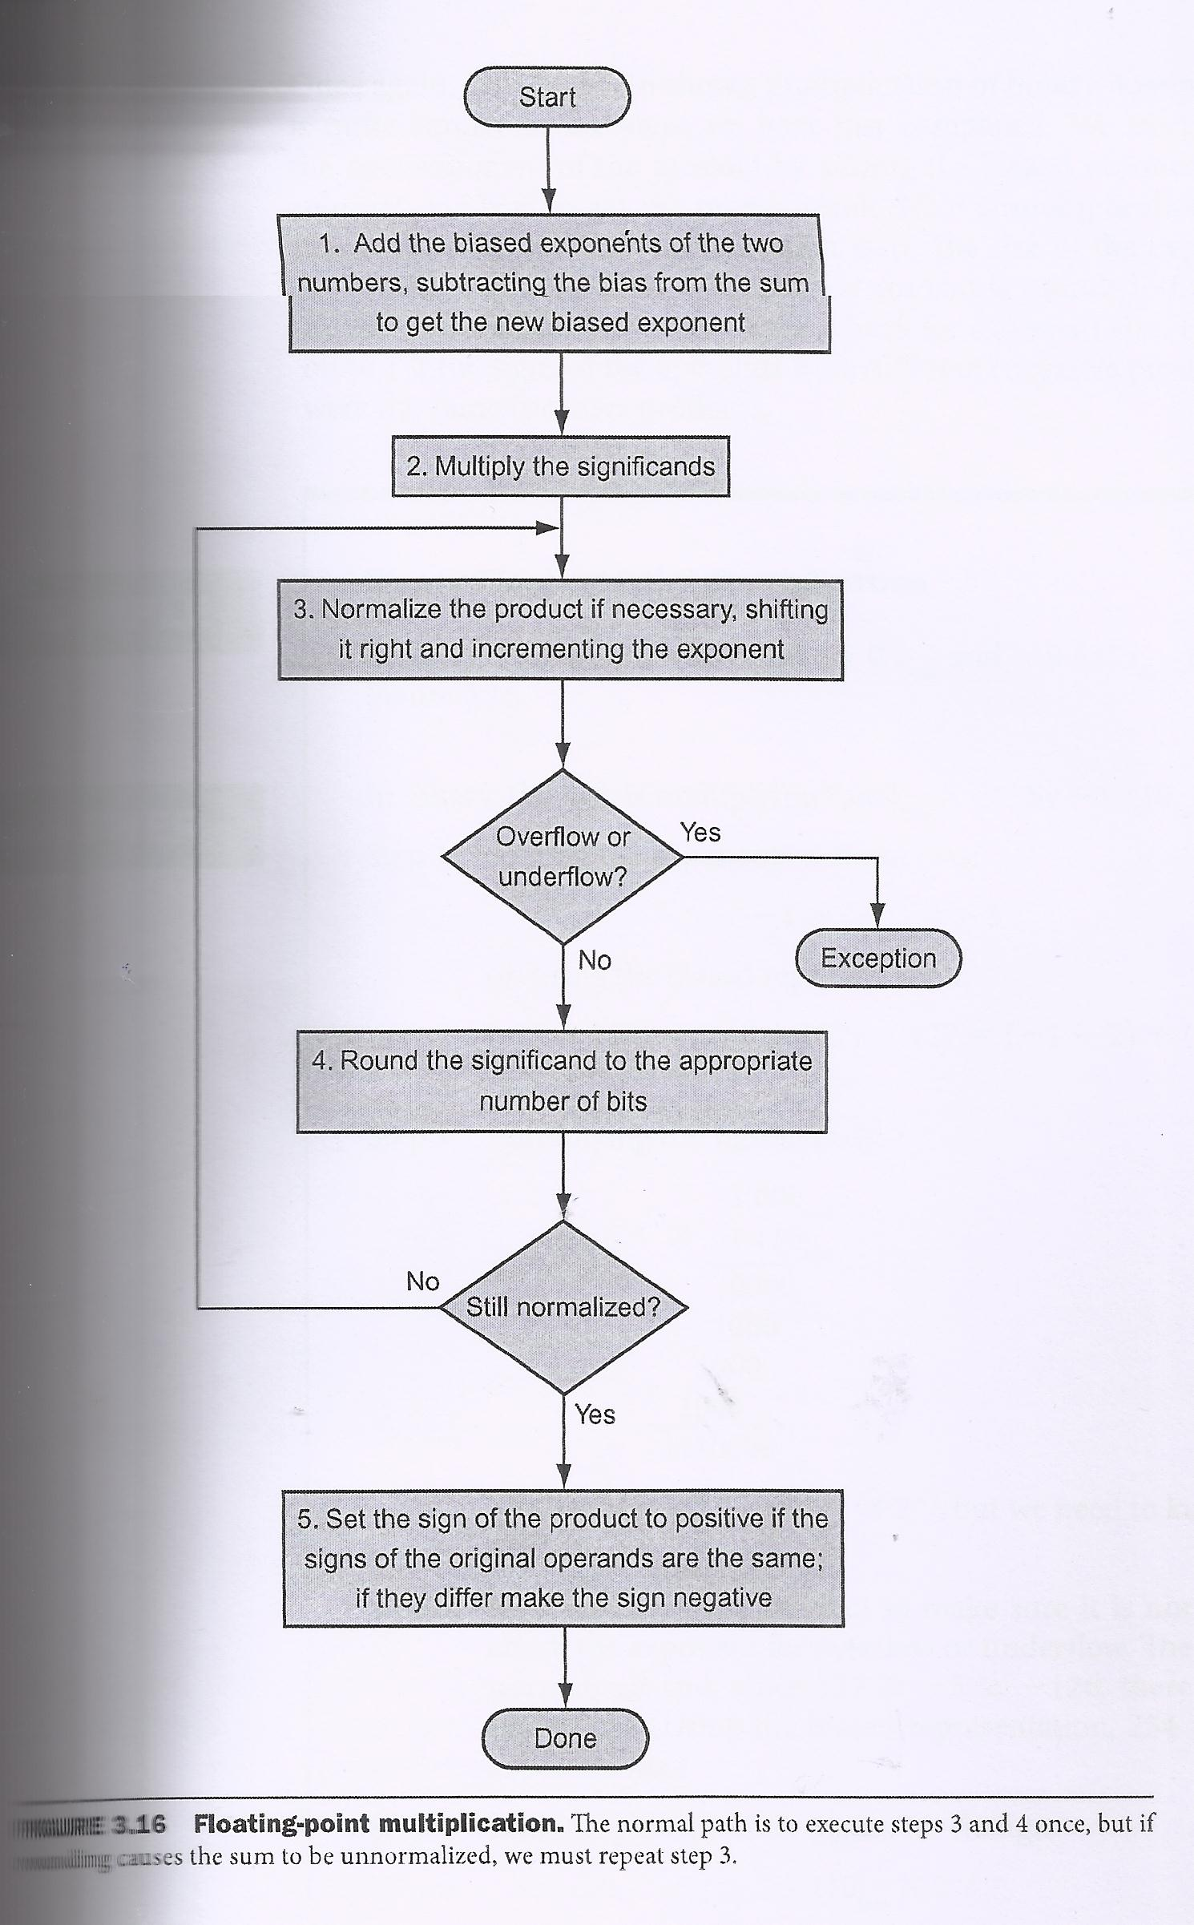
Flowchart
Floatig
Point
Number
Multipli-
-cation
Patterson
et. al.

Slide 21
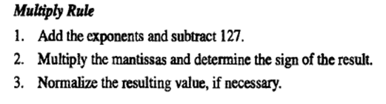

Slide 22
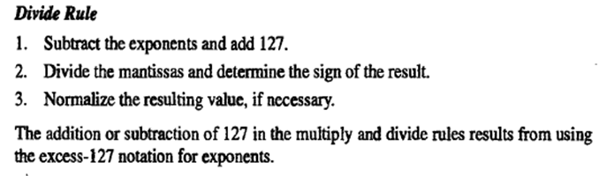

Slide 23
Floating Point Add Subtract Signs
SA | SB | Add/Sub |  | SR
1 | 0 | 1 |  | 1
0 | 0 | 1 | If E’A>E’B | 0
0 | 0 | 1 | If E’A<E’B | 1
0 | 0 | 1 | If E’A=E’B If FA>FB If FA<FB | 0 1
1 | 1 | 1 |  | 0
1 | 0 | 0 | If E’A>E’B | 1
1 | 0 | 0 | If E’A<E’B | 0
1 | 0 | 0 | If E’A=E’B If FA>FB If FA<FB | 1 0

Slide 24
Floating Point Add Subtract Signs
0 | 1 | 0 | If E’A>E’B | 0
0 | 1 | 0 | If E’A<E’B | 1
0 | 1 | 0 | If E’A=E’B If FA>FB If FA<FB | 0 1
0 | 0 | 0 |  | 0
1 | 1 | 0 |  | 1

